Slide 1
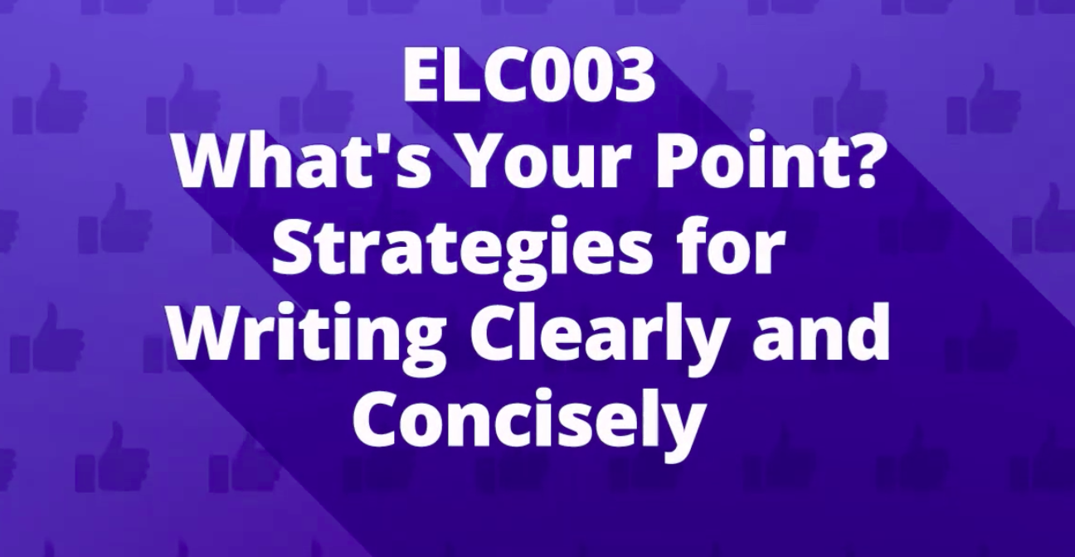
Developed by: Dr Misty Cook, Dr Tetyana (Tania) Smotrova & Ms Anita Toh

Slide 2
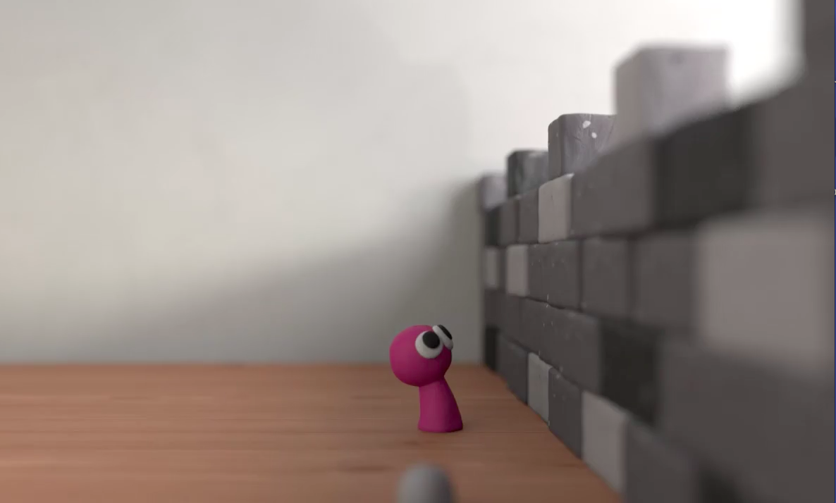
Video link: https://mediaweb.nus.edu.sg/Panopto/Pages/Viewer.aspx?id=c39b3c8a-c76e-4dbb-b7b6-c812b66073df
Notes:
https://drive.google.com/open?id=0B3nQiwcIfGVgWjBWWlRKa0pJZlU

Slide 3
Topics covered
Reader awareness
In content, presentation and language
2. Clarity
Modifiers, active/passive voices, cohesive devices, pronoun references
3. Conciseness
Wordiness & redundancy, parallel structures, nominalizations, clichés and euphemisms
4. Punctuation
Avoiding confusing use of commas, colons, semi-colons, dashes and hyphens
5. Clear and unified writing
Paragraph development and cohesion

